Slide 1
The “New” Woodland
Middle School
State of our Union
A report for WSD Board -- 3.28.16

Slide 2
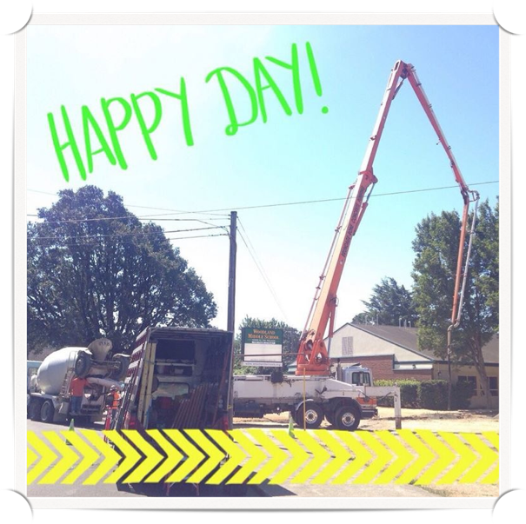
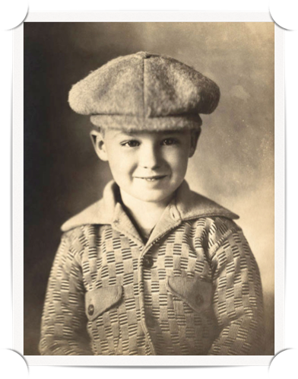
Moving Forward
The Challenge of Change
Building Success Together
VISION: WMS is WSD’s strong core, consistently finding positive ways to cultivate academic and behavioral growth in the entire learning community.

Slide 3
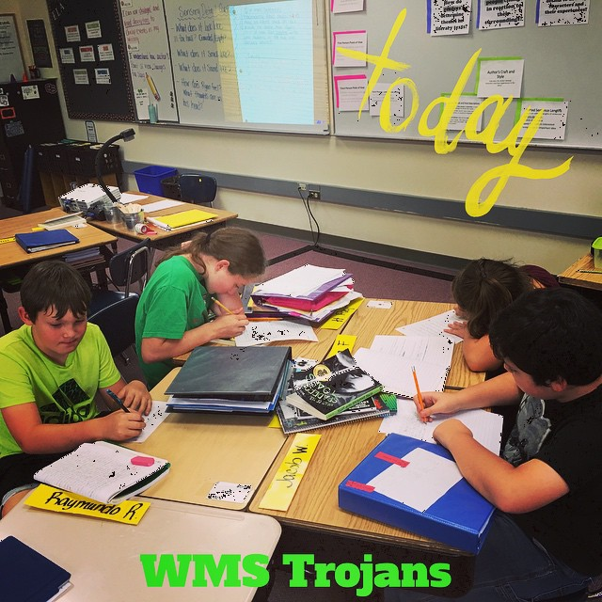
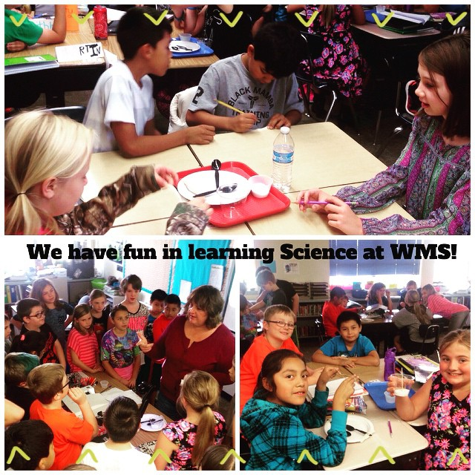
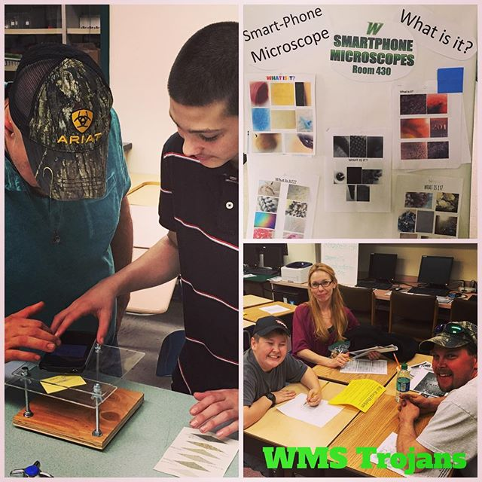
School Goal
By June 10, 2016, using 2015 Smarter Balanced Assessment scores as a baseline, at least 20% more WMS students will achieve proficiency or better on each of the Smarter Balanced Assessments.

Slide 4
Operating Principles

Slide 5
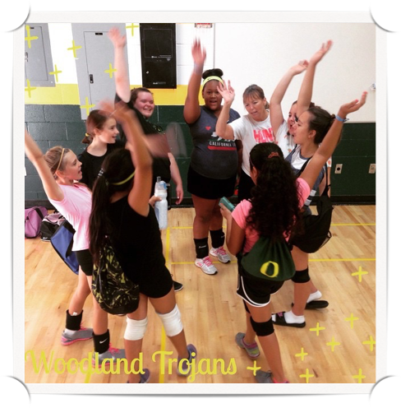
Students First
Every student knows they are awesome, loved and full of potential
Every student is “our” student
We each have different strengths and roles and we are all essential to the team
We are becoming better educators through meaningful collaboration (criteria 8)

Slide 6
Building This Plane…
as we fly it!

Slide 7
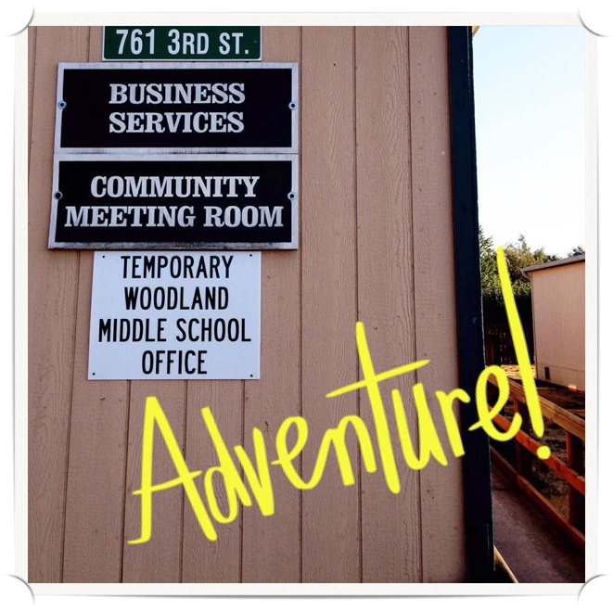
Have FUN in work? Why Not?

Slide 8
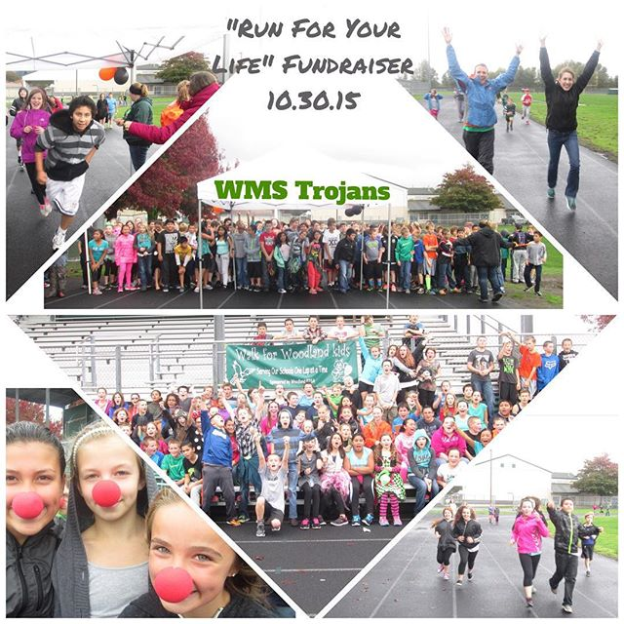
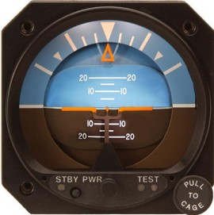
The Attitude Gauge

Slide 9
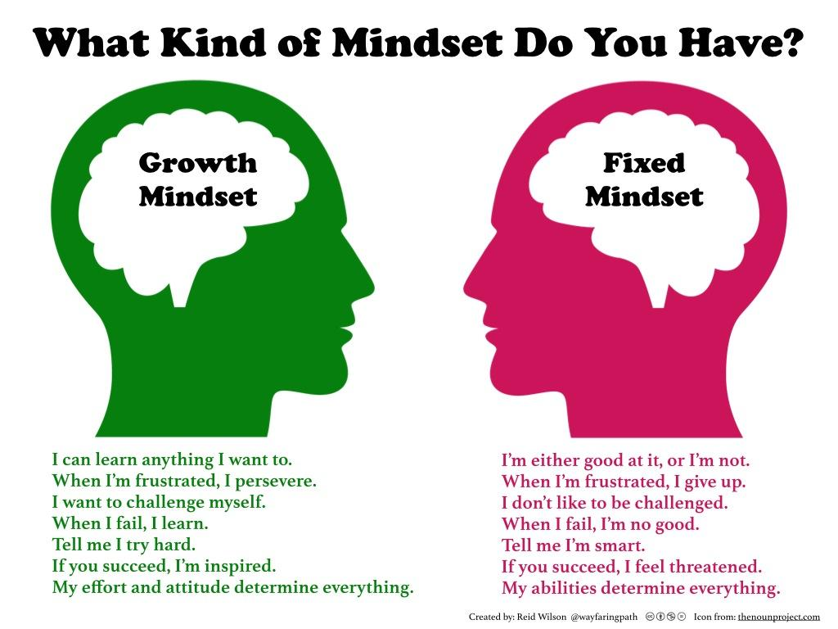
Mindset

Slide 10
Failure IS an Option
“I’ve failed over and over and over again in my life. And that is why I succeed.”
-Michael Jordan

Slide 11
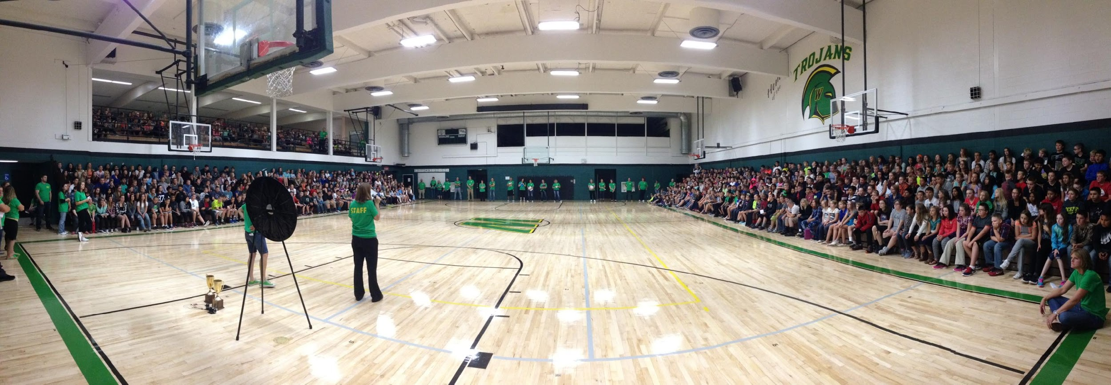
Thank You ALL for a GREAT week!
Multiple announcements
New students and families feel great
Prepared for teaching and learning
Monitor and Adjust
Help at busses and parent pick up area
Schedule changes

Slide 12
Building SUCCESS! (from a 3M)
5 minute Passing -- how’s it going? Seems much less stress
Being in the classrooms more than ever -- WOW!! This is what it is all about!
I’m learning in every class!
Science -- Volcanoes, Rockets, MSG
Art -- ya gotta go see it!
Robotics -- Mentor program for other schools
Math -- Collaboration is showing up here!
English -- Rich walls, scaffolding
PE -- Sweatin’ & Smilin’
Active Student Learning strategies (turn and talk, etc.)
Great classroom climate and culture -- so encouraging to Students!

Slide 13
WMS Administration Responsibilities
Jake | Angela
Staff Development | Athletic Director
Faculty Meetings | ASB/Leadership
Building Leadership Team | Parent/Student Handbook
Building Budget | Discipline/Attendance
Master Schedule | School Safety
Transition Coordination | Facilities
Community Liaison | State Assessment
Math, ELL, Office, SPED, Art, English, Choir, Shop, Band, Library, 5th Math/Sci/SS, STEM | PE, Science, Social Studies, Tech, 5th English/Sci/SS, PBIS, Title

Slide 14
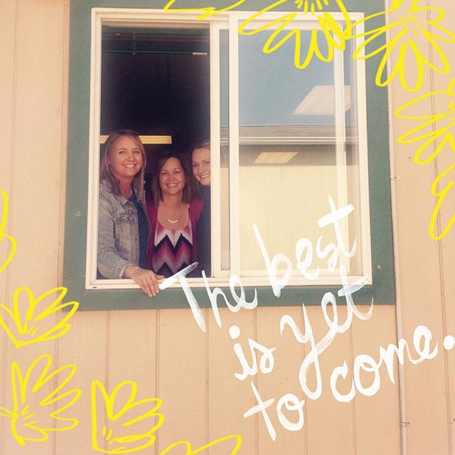
WMS Office Staff
They take initiative to make WMS/WSD better: ie. Athletic Forms/Newsletters in Spanish
Substitute Feedback Forms
Lunch Accounts
Uniquely Positive -- Find solutions to perceived problems

Slide 15
Woodland Middle School
Number of Students: 693
Free and Reduced: 42.6%
English Language Learners (ELL): 33 Students
Special Educaiton: 87 Students
McKinney Vento/Homeless Students
4-- 5th graders
7-- 6th graders
4-- 7th graders
3-- 8th graders

Slide 16
Building Safety
Drills once a month
Feedback from Drills with Staff
Radios
Doors Locked
Black Gates
24 Hour Custodian

Slide 17
PBIS at Woodland Middle School
Goal:
To improve the climate and culture for learning at WMS through intentional teaching of expectations and skills, facilitating social emotional learning, and keeping consistent and predictable expectations, rewards, and consequences.
Vision:
A positive culture and climate at WMS, where all stakeholders have influence and inclusion.

Slide 18
School Wide Expectations at WMS
The expectations are designed to provide consistency for students
Expectations will be revisited consistently by staff. They are posted throughout the school and in classrooms as a reminder for everyone.
Students choose the level of success that they have at school. If a student chooses to follow expectations they will be successful.

Slide 19
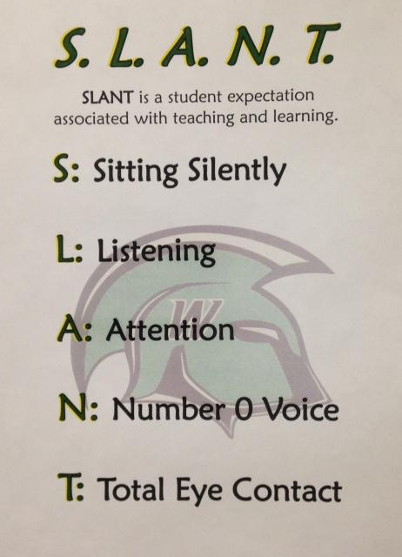
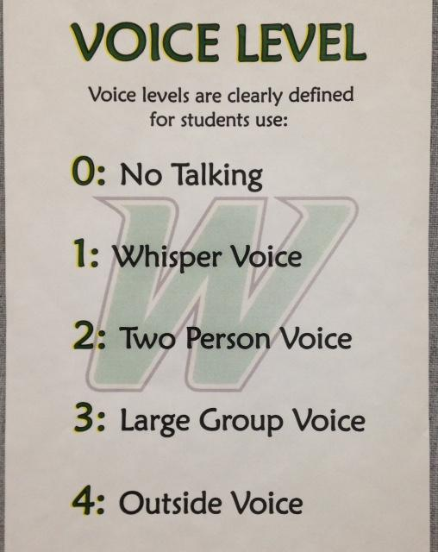
School Wide Expectations

Slide 20
Level One Rewards: Weekly
What: Trojan Tickets
Staff’s Job: Give out as many as you can to motivate students
Student’s Job: Write names and Grade on Back of the ticket & Drop them in the library (Boxes will be provided and labeled with 5/6th or 7/8th
Reward:Wheel Drawing on Wednesday’s @ Lunch (4 from each grade band/box)
Who is responsible:5th-8th grade leadership
Notes:
Robin and Colleen’s Slide

Slide 21
Level Two Rewards: Bi-Weekly
What: Trojan Pride Slips using the pride acronym (replace awesome slips)
Staff’s Job: To fill out slips and give to students who are demonstrating characteristics from the PRIDE acronym (Perseverance, respect, integrity, determination, and empathy)
Student’s Job: Bring them to the office and drop them in the boxes (5/6th or 7/8th) and take a copy home
Reward: Drawing will take place @ assemblies bi-weekly/trojan button
(2 from each grade band/box)
Who is responsible: 5th- 8th grade leadership & PBIS Team
Notes:
Cyndi and Kelly’s Slide

Slide 22
Level Three Rewards: Monthly
What: Student Of The Month
Staffs Job: Nominate students who are showing growth in your classrooms, academics, or behavior
Reward: Certificate, pin, assembly recognition
(Once the pins have run out we will begin handing out t-shirts that say “Trojan Pride”)
Who is responsible: PBIS TEAM
Notes:
Cheryl and Kelly’s Slide

Slide 23
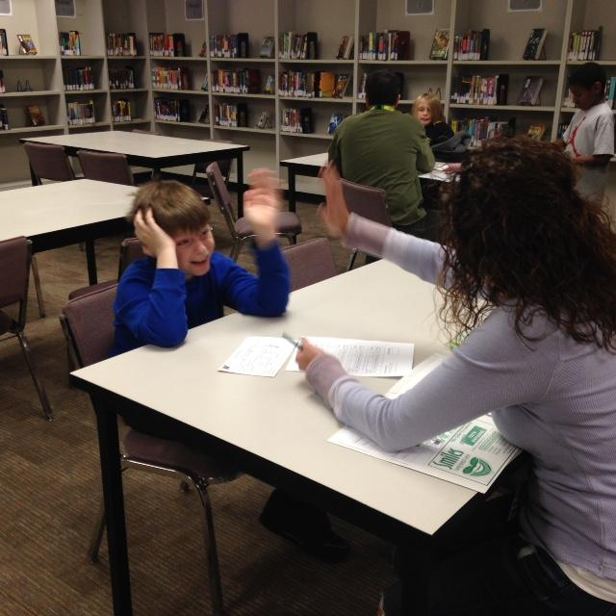
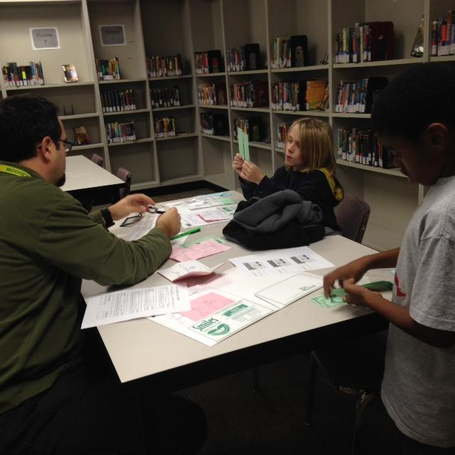
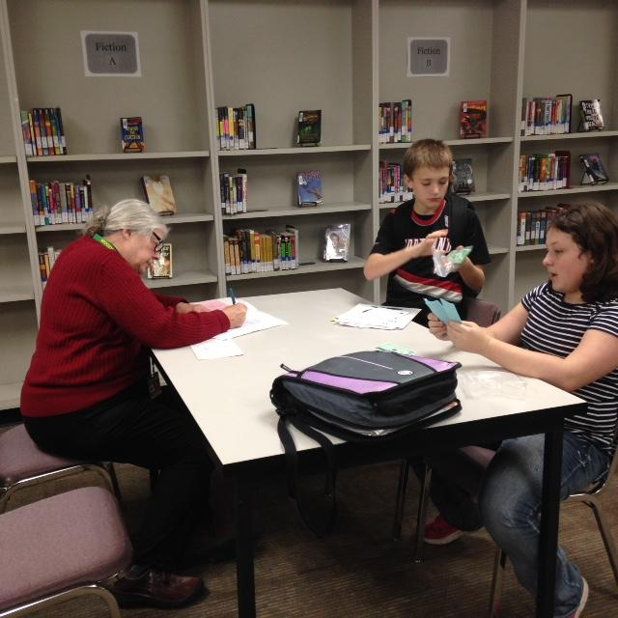
Fresh Start @ WMS

Slide 24
Fresh Start : How we do it
After observing student concerns...
*Teacher opens GIT-BIT in the SIPS System
*Teacher completes Fresh Start referral
*Team Reviews and recommends….
1. Approval
2. Non-Approval
3. Parent Refusal

Slide 25
Fresh Start: Why we do it
To improve student accountability & structure
Improve student behavior & academics
Provide feedback and adult support on a daily basis
Improve and establish daily home/school communication
Improve student organization & motivation
Helps students to self-monitor
Internalizes success & accomplishment of set goals
Get students involved & excited about the program
Helps teach responsible behaviors & habits

Slide 26
Fresh Start: When we do it
For a student who responds well to, or seeks, adult attention and (one or more of the following)....
Has failed to respond to other interventions
Is not participating, being involved or taking part in the learning process
Has emotional issues, exhibiting behavioral problems, and/or demonstrates low motivation and effort

Slide 27
Fresh Start: What does support look like
Daily check in/out with a Fresh Start Staff Member
Organizational Skills/Homework Checks
Goals set for daily classrooms behaviors and/or routines
Accountability for students
Connections made with a Fresh Start Staff Member
Think Tank Resets/Intervention
Observations in classrooms done by Fresh Start Staff
Communication with Teachers and Fresh Start Staff
Communication with Parents/Guardians

Slide 28
Think Tank
Think Tank is FOR…….
Resolution room to re-teach expectations and behaviors
A place for Fresh Start Students to have a “BREAK” and “Reset”
Think Tank is NOT…..
Not a place for punishment
Not a place to send a student you need out of your classroom for an extended amount of time

Slide 29
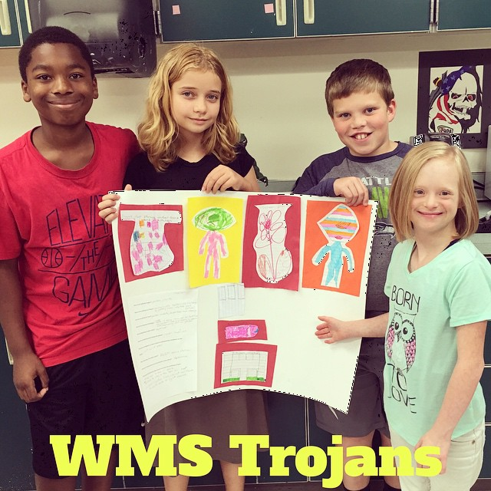
Standards Implementation
Washington State Learning Standards
Next Generation Science Standards
Professional Development
English, Math, Science, Tech
Master Schedule of classes
Collaboration
Chrome Carts

Slide 30
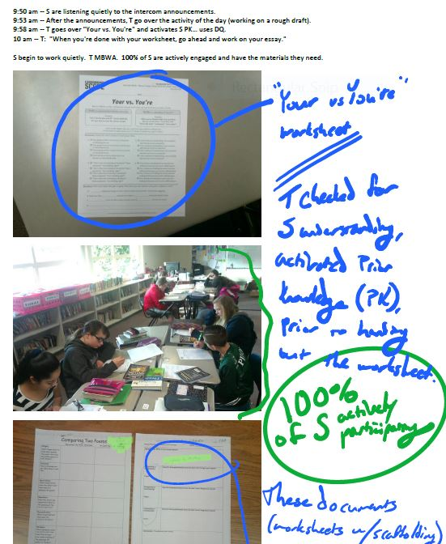
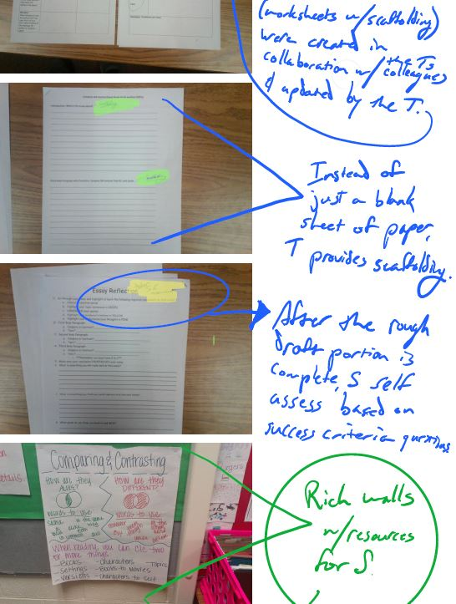
Pro Growth

Slide 31
State Testing @ WMS
Staff Training
Staff Members took the online certification
On-going Training during the Interim Assessments
Collaboration
State Assessment Requirements
5th, 6th, 7th, & 8th Grade SBA ELA & Math
5th & 8th MSP Science
ALL STUDENTS AT WMS
Interim Practice now and why?
Feedback to the Staff & Students (Next Steps)
Schedule: Least impact on classroom instruciton
Format of Questions, Keyboarding, and Maniopulatives

Slide 32
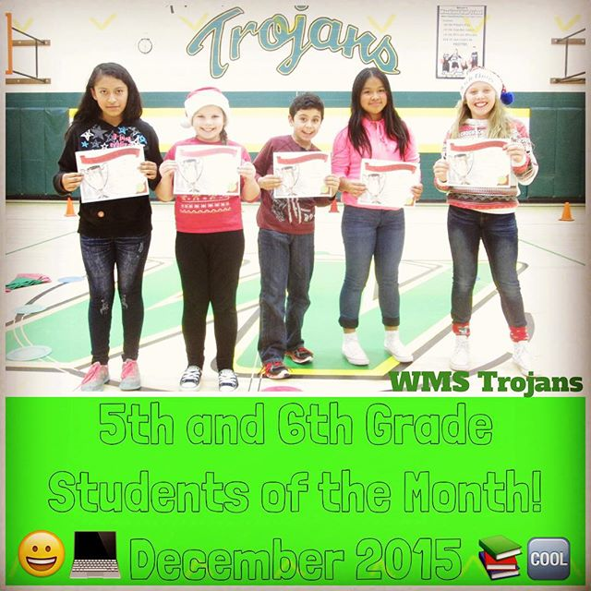
Student Achievement Data
WMS Extension
Students placed based on assessment data and teacher input
Data analysis team

Slide 33
WSD State Assessment Achievement Data
Percentage of 5-8 grade students at or above standard on the state assessment in 2014-15:
SBAC 2014-15 | 5th | 6th | 7th | 8th
ELA | 46.6% | 49.7% | 63.5% | 55.5%
Math | 52.5% | 42.6% | 56.2% | 46.9%
By June 10, 2016, using 2015 Smarter Balanced Assessment scores as a baseline, at least 20% more WMS students will achieve proficiency or better on each of the Smarter Balanced Assessments.

Slide 34
Student Involvment @ WMS
Sports for 7th/8th Grade Students
Football, Cross Country, Volleyball, Basketball, Wrestling, Knowledge Bowl, Golf, & Track
Activities
5-8th Grade Leadership, 7th/8th Jr. Honor Society, 5/6th Drawing Club, 8th Grade Girls Trip, Grade Level Field Trips, 5/6th Movie Nights, 7/8th Dances, ASB, Chorus, Band, 5th Grade Wax Museum & Talent Show
Science & Math Extension Nights
6th Grade Science Fair and Math Extension Night: How Strong is your Bridge?
Robotics Team
The LEGO robotics team is coached by Mr. Brown. It is a semester long elective made up of six to ten students.

Slide 35
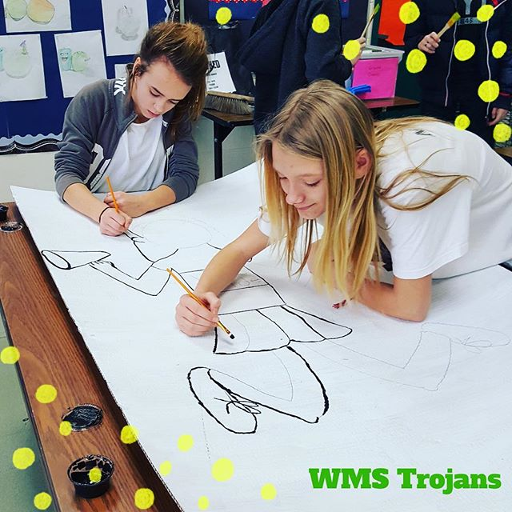
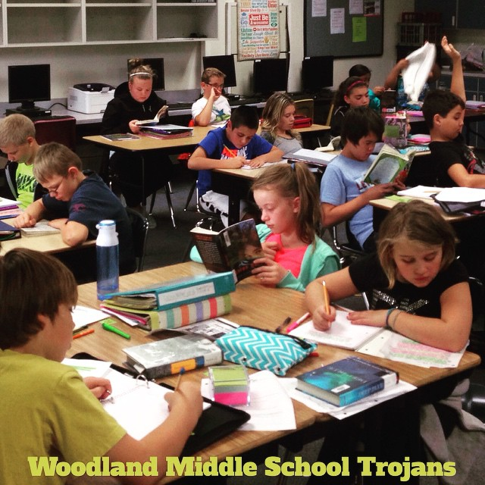
WMS Vision
WMS is WSD’s strong core, consistently finding positive ways to cultivate academic and behavioral growth in the entire learning community.

Slide 36
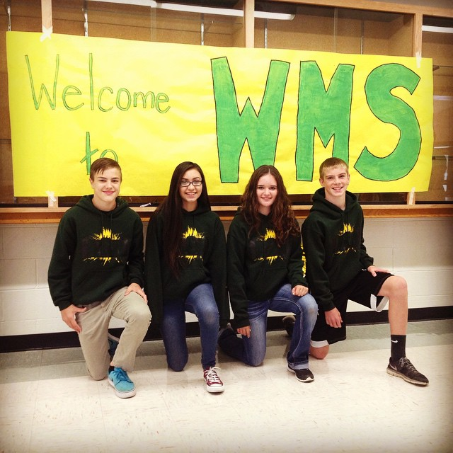
Cultivating Growth
More extracurricular activities for all students
Increased Teacher Leadership Opportunities

Slide 37
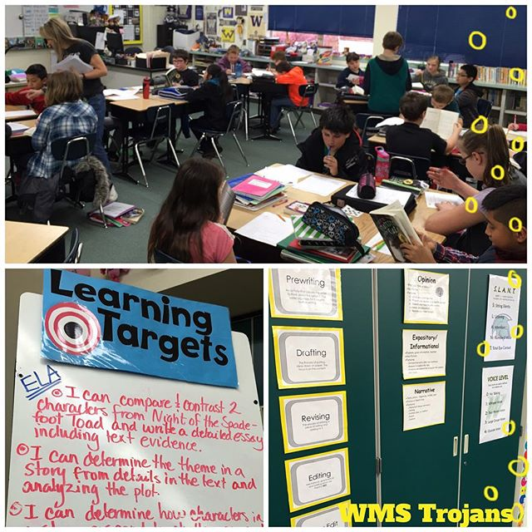
Questions?

